Slide 1
Predicting Customer Churn in Telecom Companies Using Machine Learning
Data and Knowledge Mining using R Programming

Slide 2
Team Members
Kaung Myat Htun
Yan Paing Win
Myat Thu Kyaw
Ye Win Htun
YKPT - 20637
YKPT - 20629
YKPT - 20481
YKPT - 20870
Min Thway Khaing
Thet Paing Oo
Thurein Soe
Aung Ko Ko Khant
YKPT - 22207
YKPT - 20613
YKPT - 20473
YKPT – 20479

Slide 3
Table of contents
01
02
03
04
05
06
Introduction
Business Goals
Preparing Data
Conclusion
Model Selection – XGBoost
Evaluation Results

Slide 4
01
Introduction
1.1. Why This Matter
1.2. Project Objectives 1.3. Dataset & Methodology
1.4. Expected Outcomes

Slide 5
Introduction
In the highly competitive telecommunications industry, customer retention is a critical
driver of profitability and sustainable growth. Customer churn—the phenomenon of
subscribers discontinuing their services—represents a significant financial burden, with
studies indicating that acquiring a new customer can cost 5–7 times more than retaining an
existing one according to Harvard Business Review. For telecom companies, even a modest
reduction in churn rates can translate to millions of dollars in preserved revenue, making
proactive churn prediction and mitigation a strategic priority.
This project leverages machine learning to address the challenge of customer churn by
developing a predictive model that identifies at-risk customers before they discontinue
services. Using a real-world dataset of 7,043 telecom customers, we analyze behavioral and
demographic features—such as tenure, contract type, monthly charges, and service usage
patterns—to uncover actionable insights and predict churn likelihood.

Slide 6
1.1 Why This Matters
Financial Impact:
The global telecom industry loses an estimated $15–20 billion
annually due to churn (IBM).
Operational Efficiency:
Targeted retention strategies informed by machine learning
can reduce marketing costs by focusing resources on high-risk customers.
Customer Experience:
Proactive interventions, such as personalized offers or service
improvements, enhance customer satisfaction and loyalty.

Slide 7
1.2 Project Objectives
Predictive Modeling:
Build a robust machine learning system to forecast churn
probability with >85% AUC-ROC accuracy.
Feature Analysis:
Identify key drivers of churn (e.g., contact flexibility, pricing tiers) to guide business strategies.
Actionable Insights:
Provide telecom providers with data-driven recommendations to improve retention rates.

Slide 8
1.3 Dataset & Methodology
Data Source:
Kaggle Telco Customer Churn Dataset, containing 21 features spanning
customer demographics, account details, and service usage.
Preprocessing:
Address missing values, encode categorical variables, and engineer
features like tenure groups and high-risk customer flags.
Machine Learning Model:
XGBoost selected for its superior performance in
handling class imbalance and interpretability.

Slide 9
1.4 Expected Outcomes
• A deployable XGBoost model that ranks customers by churn risk, enabling targeted retention campaigns.
• Visualization of critical churn drivers (e.g., month-to-month contracts, high monthly charges).
• Strategic recommendations to reduce churn rates by 20–30% through personalized interventions.
By bridging advanced analytics with business strategy, this project empowers telecom companies to transform raw data into actionable retention tools, fostering long-term customer relationships and driving sustainable revenue growth.

Slide 10
02
Business Goals
2.1. Business Problems
2.2. Objectives

Slide 11
Business Goals
The primary business goal of predicting customer churn in telecom companies using machine learning is to enhance customer retention strategies, minimize revenue loss, and improve overall customer satisfaction. By leveraging advanced data analysis techniques, telecom companies can proactively identify at-risk customers and tailor interventions to retain them, thus, fostering long-term profitability and reducing operational costs.

Slide 12
2.1 Business Problems
1. High Customer Attrition: Telecom companies often face high levels of churn, which impacts revenue, customer loyalty, and brand reputation. Retaining existing customers is usually more cost-effective than acquiring new ones, making churn prediction a priority.
2. Inefficient Resource Allocation: Without accurate churn predictions, companies may waste resources on customers who are not likely to churn while overlooking those who are at a high risk of leaving.
3. Lack of Targeted Marketing: Generic marketing campaigns do not address the specific needs of at-risk customers. This leads to ineffective retention efforts and customer dissatisfaction, which ultimately drives more customers to churn.
4. Limited Customer Insights: Telecom companies often lack deep insights into the behavior and preferences of customers, making it difficult to understand why customers churn. Without this understanding, it becomes hard to address the root causes of churn.
5. Competitive Market: The telecom industry is highly competitive, with many providers offering similar services. This makes it easy for customers to switch providers, especially if they feel undervalued or underserved. Predicting churn allows telecom companies to act before customers make that switch.

Slide 13
2.2 Objectives
1. Reduce Churn Rate: Lower customer attrition by identifying high-risk customers and deploying retention strategies.
2. Improved Retention Strategies: Use predictive insights to implement targeted retention campaigns such as loyalty programs, special offers, or customized communication to at-risk customers.
3. Optimize Resource Allocation: By identifying the most cost-effective retention strategies, telecom companies can allocate marketing and customer support resources more efficiently.
4. Customer Lifetime Value (CLV) Enhancement: Increase the average customer lifetime value by identifying high-value customers at risk of churning and providing them with the right incentives to stay.
By addressing these objectives and business problems, telecom companies can significantly reduce churn, improve customer relationships, and ultimately increase profitability.

Slide 14
03
Preparing Data
3.1. Dataset Selection
3.2. Exploratory Data Analysis (EDA) Section 3.3. Feature Engineering & Data Preprocessing

Slide 15
Preparing Data
3.1 Dataset Selection
Chosen Dataset: Telco Customer Churn Dataset (Kaggle)
• Reason for choosing this dataset
o It was specifically designed for churn prediction in telecom, with 7,043 records and 21 features.
o It features customer demographics (e.g., gender, SeniorCitizen), account details (e.g., tenure, contract type), and service usage (e.g., MonthlyCharges, InternetService).
o It also includes the column for Churn (binary: Yes/No), ideal for classification tasks.
o Most importantly, the data mirrors actual telecom business challenges, enabling practical insights.

Slide 16
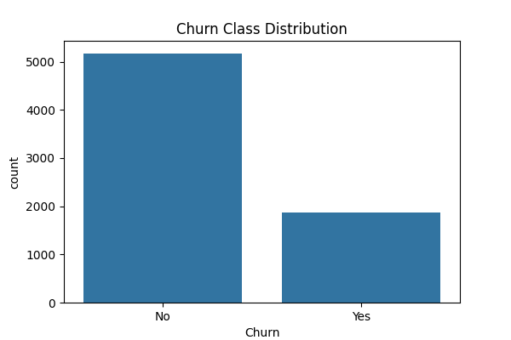
3.2 Exploratory Data Analysis (EDA) Section
1. Teleco Customer Churn
• Data consists of 7043 entries and 20 columns.
• SeniorCitizen, tenure, mountlycharges data are numeric while other variables are categorical.
• The TotalCharges property must consist of numeric data. So, we convert the data in this column to int type.
df['TotalCharges'] = pd.to_numeric(df['TotalCharges’], errors='coerce’)
• When the SeniorCitizen data was analyzed, it was found that the values 0 and 1 should be changed to Yes and True.
df["SeniorCitizen"] = df["SeniorCitizen"].map({0:"No", 1:"Yes"})
2. Data Visualizations
• Graph of the number of people who canceled their subscription and those who did not, and those who canceled are indicated with yes.
plt.figure(figsize=(6, 4))
sns.countplot(x="Churn", data=df)
plt.title("Churn Class Distribution")
plt.show()
Fig: Churn Class Distribution

Slide 17
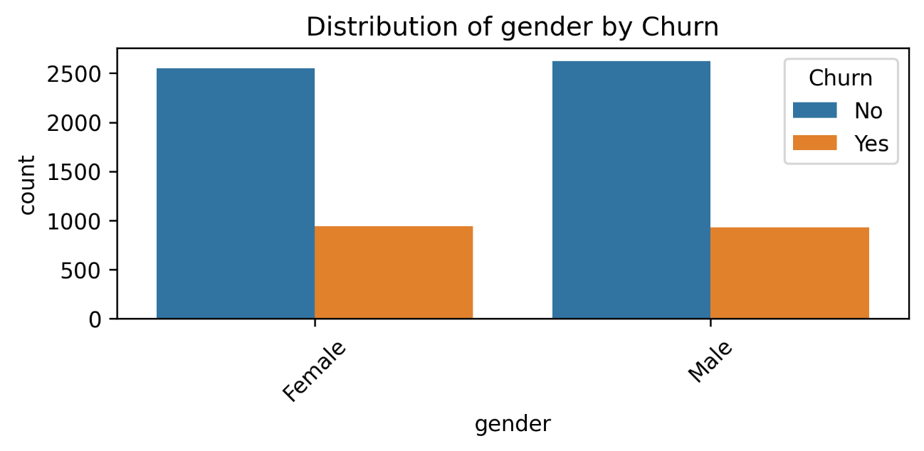
We also visualized the rest of the data distributions by churn, but we didn’t put in all of the images. for the categorical_cols since there are too many of them; instead, we added analysis graphic.
target = "Churn"
categorical_cols, numerical_cols = [], []
for col in columns_name:
if col == target:
continue
if df[col].dtype == "object":
categorical_cols.append(col)
else:
numerical_cols.append(col)
print("Categorical Columns:", categorical_cols)
print("Numerical Columns:", numerical_cols)
for col in categorical_cols:
plt.figure(figsize=(6, 3))
sns.countplot(x=col, hue=target, data=df)
plt.title(f"Distribution of {col} variable by Churn")
plt.xticks(rotation=45)
plt.show();
Fig: Distribution of Gender by Churn

Slide 18
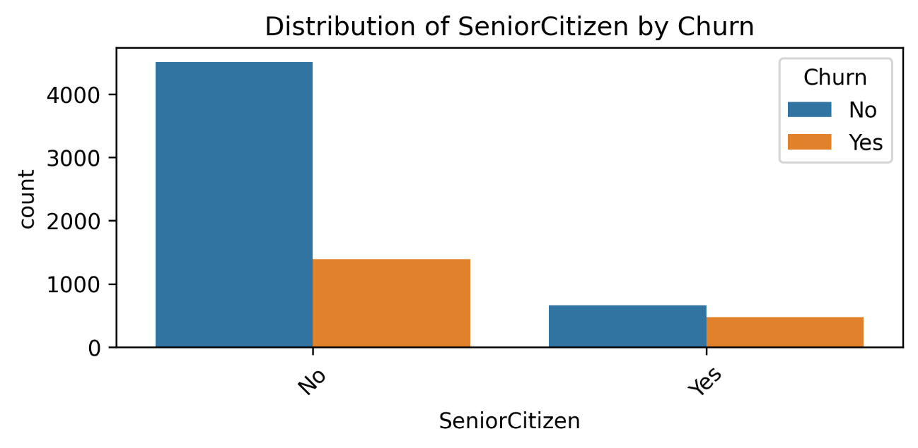
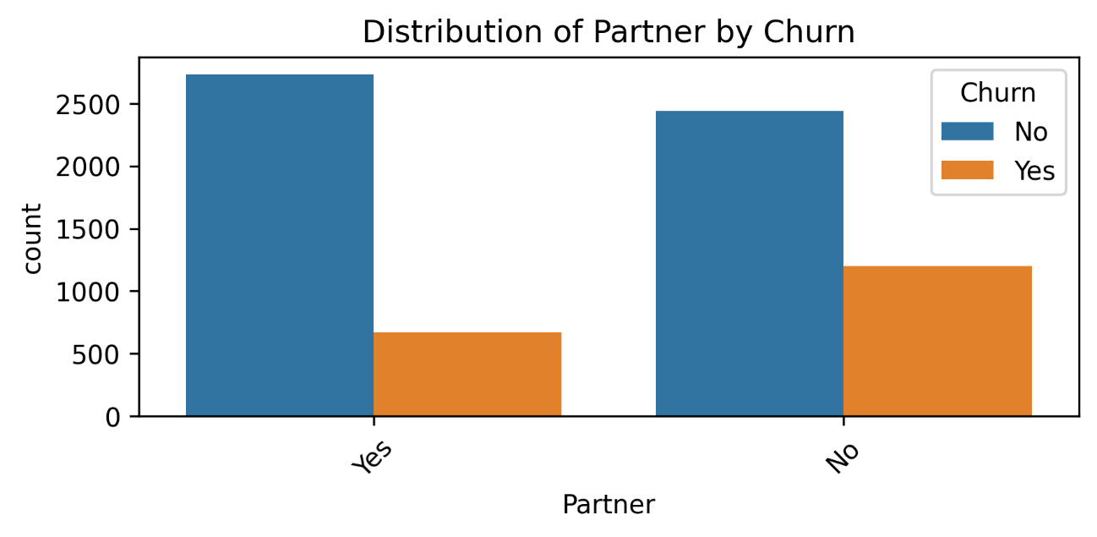
Fig: Distribution of Senior Citizen by Churn
Fig: Distribution of Partner by Churn

Slide 19
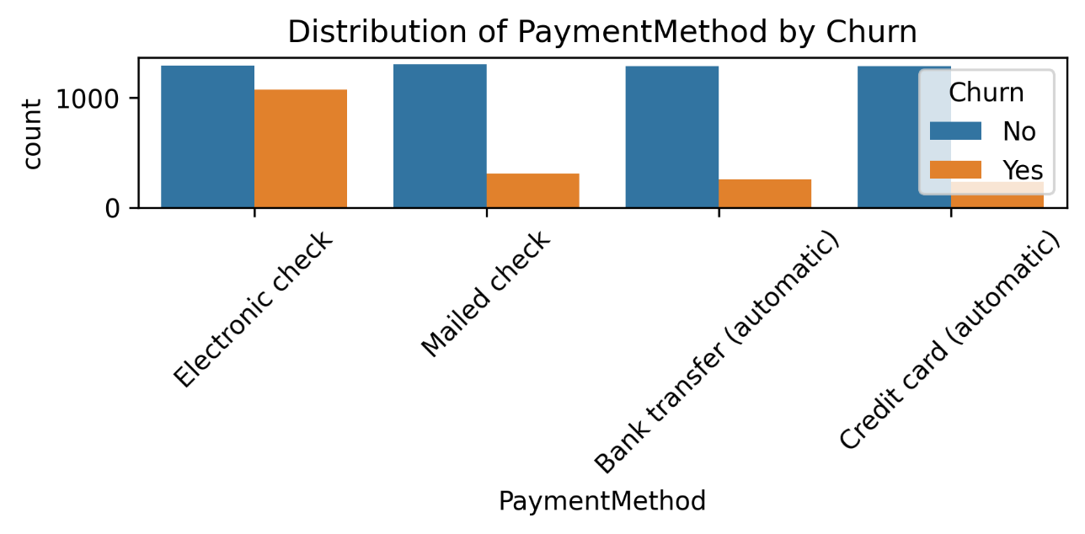
Fig: Distribution of Payment Method by Churn

Slide 20
Analysis Graphic
for col in categorical_cols:
col_churn = df.groupby(col)['Churn'].value_counts(normalize=True) print(col_churn)
gender Churn
Female No 0.730791
Yes 0.269209
Male No 0.738397
Yes 0.261603
Name: proportion, dtype: float64
SeniorCitizen Churn
No No 0.763938
Yes 0.236062
Yes No 0.583187
Yes 0.416813
Name: proportion, dtype: float64
Partner Churn
No No 0.670420
Yes 0.329580
Yes No 0.803351
Yes 0.196649
Name: proportion, dtype: float64
Dependents Churn
No No 0.687209
Yes 0.312791
Yes No 0.845498
Yes 0.154502
Name: proportion, dtype: float64

Slide 21
PhoneService Churn
No No 0.750733
Yes 0.249267
Yes No 0.732904
Yes 0.267096
Name: proportion, dtype: float64
MultipleLines Churn
No No 0.749558
Yes 0.250442
No phone service No 0.750733
Yes 0.249267
Yes No 0.713901
Yes 0.286099
Name: proportion, dtype: float64
InternetService Churn
DSL No 0.810409
Yes 0.189591
Fiber optic No 0.581072
Yes 0.418928
No No 0.925950
Yes 0.074050
Name: proportion, dtype: float64
OnlineSecurity Churn
No No 0.582333
Yes 0.417667
No internet service No 0.925950
Yes 0.074050
Yes No 0.853888
Yes 0.146112
Name: proportion, dtype: float64
OnlineBackup Churn
No No 0.600712
Yes 0.399288
No internet service No 0.925950
Yes 0.074050
Yes No 0.784685
Yes 0.215315
Name: proportion, dtype: float64
DeviceProtection Churn
No No 0.608724
Yes 0.391276
No internet service No 0.925950
Yes 0.074050
Yes No 0.774979
Yes 0.225021
Name: proportion, dtype: float64
TechSupport Churn
No No 0.583645
Yes 0.416355
No internet service No 0.925950
Yes 0.074050
Yes No 0.848337
Yes 0.151663
Name: proportion, dtype: float64

Slide 22
StreamingTV Churn
No No 0.664769
Yes 0.335231
No internet service No 0.925950
Yes 0.074050
Yes No 0.699298
Yes 0.300702
Name: proportion, dtype: float64
StreamingMovies Churn
No No 0.663196
Yes 0.336804
No internet service No 0.925950
Yes 0.074050
Yes No 0.700586
Yes 0.299414
Name: proportion, dtype: float64
Contract Churn
Month-to-month No 0.572903
Yes 0.427097
One year No 0.887305
Yes 0.112695
Two year No 0.971681
Yes 0.028319
Name: proportion, dtype: float6
PaperlessBilling Churn
No No 0.836699
Yes 0.163301
Yes No 0.664349
Yes 0.335651
Name: proportion, dtype: float64
PaymentMethod Churn
Bank transfer (automatic) No 0.832902
Yes 0.167098
Credit card (automatic) No 0.847569
Yes 0.152431
Electronic check No 0.547146
Yes 0.452854
Mailed check No 0.808933
Yes 0.191067
Name: proportion, dtype: float64

Slide 23
The number of people who canceled their subscription is lower than those who did not cancel.
On average, 26% of both men and women canceled their subscriptions. ### Demographics
Elderly customers are more likely to cancel their subscriptions compared to younger customers
Married customers are less likely to cancel their subscriptions compared to single customers.
Customers with dependent family members (Dependents = Yes) show a lower cancellation rate. ### Phone Services
Customers who do not receive phone service (PhoneService = No) have a slightly lower cancellation rate.
Unsubscribe rate for those without a single line: 25%, unsubscribe rate for those with multiple lines: 28% Unsubscription rate for customers with no phone service (MultipleLines = No phone service):24% ### Internet Services
DSL users have a lower cancellation rate compared to fiber optic users.
Customers using online security, online backup, or tech support services are less likely to cancel their subscriptions. ### Billing and Contract
Long-term contracts encourage customer retention.
Customers using paperless billing are more likely to cancel their subscriptions.
We observe that customers with high monthly subscription fees leave the company in the first few months.
plt.figure(figsize=(8, 4))
sns.scatterplot(data=df, x="tenure", y="MonthlyCharges", hue=target, alpha=0.6)
plt.title("Tenure and MonthlyCharges with Churn")
plt.tight_layout()
plt.savefig('../results/plots/Tenure_and_monthlyCharges_scatterplot.png', bbox_inches='tight')
plt.show()

Slide 24
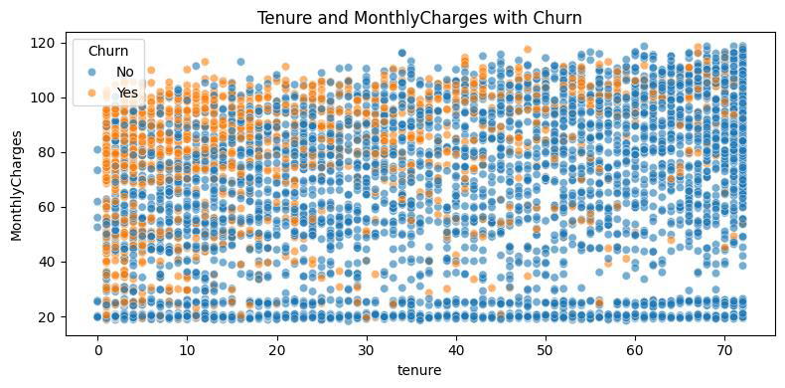
Customers who use Electronic Check payment method and have high Monthly Charges have high churn rate.
df['MonthlyChargesGroup'] = pd.cut(df['MonthlyCharges'], bins=5)
# Churn rate pivot table
churn_rate = df.pivot_table(values='Churn’,
index='PaymentMethod’,
columns='MonthlyChargesGroup’,
observed=False,
aggfunc=lambda x: (x == 'Yes').mean())
# Costumer number pivot table
customer_count = df.pivot_table(values='Churn’,
index='PaymentMethod’,
columns='MonthlyChargesGroup’,
observed=False,
aggfunc='count’)
# Rate and number of customer are combined
churn_rate_rounded = churn_rate.round(2)
combined_data = churn_rate_rounded.astype(str) + "\n(" + customer_count.astype(int).astype(str) + ")"
Fig: Tenure and MonthlyCharges with Churn (Scatter Plot)

Slide 25
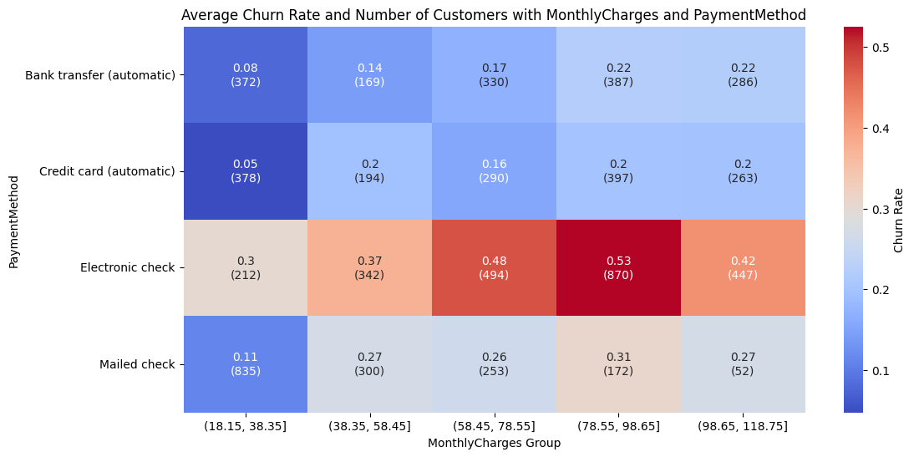
# Heatmap table
plt.figure(figsize=(12, 6))
sns.heatmap(churn_rate, annot=combined_data, fmt="", cmap='coolwarm', cbar_kws={'label': 'Churn Rate'})
plt.title('Average Churn Rate and Number of Customers with MonthlyCharges and PaymentMethod')
plt.xlabel('MonthlyCharges Group')
plt.ylabel('PaymentMethod')
plt.savefig('../results/plots/Churn_rate_heatmap.png', bbox_inches='tight')
plt.show()
Fig: Churn Rate Heatmap

Slide 26
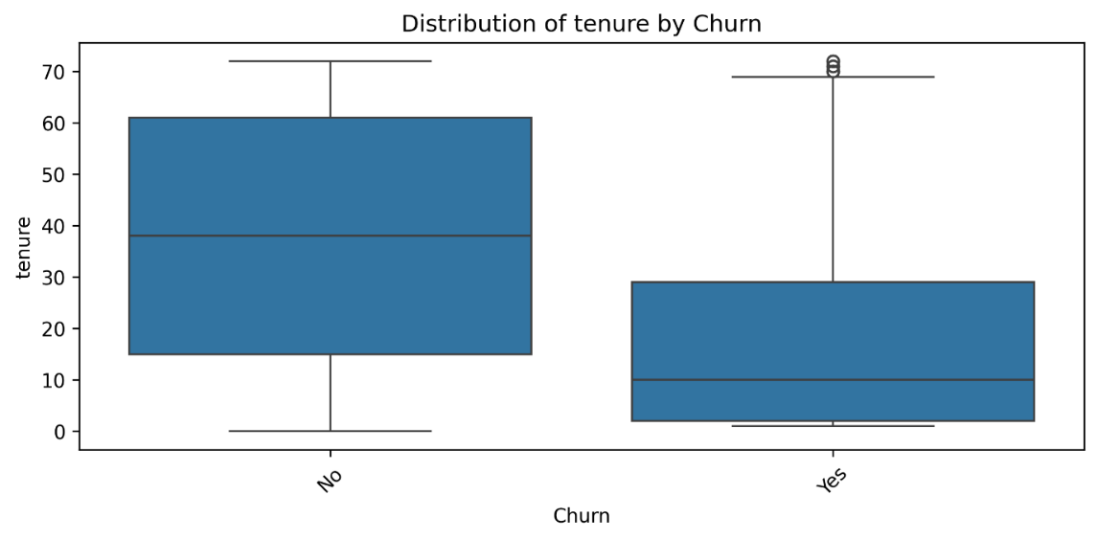
Distribution of data by Churn in numerical columns.
for col in numerical_cols:
plt.figure(figsize=(8, 4))
sns.boxplot(x=target, y=col, data=df)
plt.title(f" Distribution of {col} variable by Churn")
plt.show()
Fig: Distribution of tenure by Churn

Slide 27
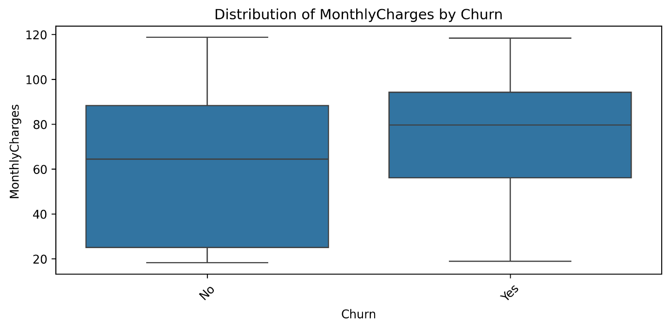
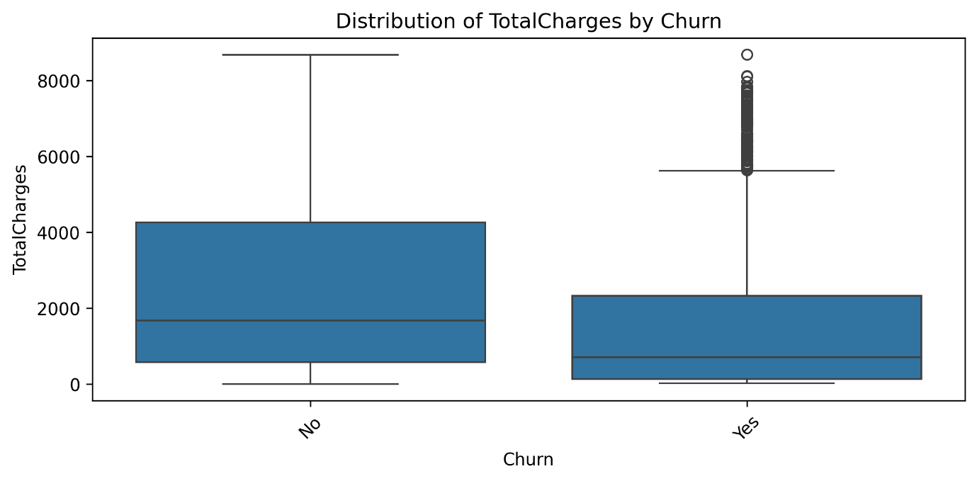
Fig: Distribution of MonthlyCharges by Churn
Fig: Distribution of TotalCharges by Churn

Slide 28
3.3 Feature Engineering & Data Preprocessing
1. Feature Engineering
We created a "High-Risk Customers" Feature by flagging customers who are likely to churn base on these conditions (payment method, short tenure duration, and high monthly charge rate).
class HighRiskFeatureGenerator(BaseEstimator, TransformerMixin):
def __init__(self):
self.train_80th_ = None
def fit(self, X, y=None):
# Calculate percentile from TRAINING DATA only
self.train_80th_ = X['MonthlyCharges'].quantile(0.8)
return self
def transform(self, X):
X = X.copy()
X['HighRiskCustomers'] = (
(X['PaymentMethod'] == 'Electronic check') &
(X['MonthlyCharges'] > self.train_80th_)
).astype(int)
return X

Slide 29
2. Encoding
• Since we are doing Churn Analysis, the target ‘Churn’ column needed to be converted to binary values.
df['Churn'] = df['Churn'].map({'Yes': 1, 'No': 0})
• Split the target and feature columns, then split the data for training and testing
X = df.drop(columns=['Churn’])
y = df['Churn’]
X_train, X_test, y_train, y_test = train_test_split(
X, y,
test_size=0.2,
random_state=42,
stratify=y
)
• The missing values are handled, the numerical columns are scaled, and categorical columns are one-hot encoded in the model pipeline setup.
• Imbalance Class problem in the data is also addressed using SMOTE ensemble method.
pipeline = Pipeline([
('imputer', DataFrameImputer(numerical_cols, strategy='median')),
('feature_engineer', HighRiskFeatureGenerator()),
('preprocessor', ColumnTransformer([
('num', StandardScaler(), numerical_cols),
('cat', OneHotEncoder(handle_unknown='ignore'), categorical_cols)
], remainder='passthrough')),
('smote', SMOTE(random_state=42)),
('classifier', XGBClassifier())
])

Slide 30
04
Model Selection – XGBoost
4.1. Model Introduction
4.2. Advantages Over Other Models
4.3. Training the Model

Slide 31
Model Selection - XGBoost
4.1 Model Introduction
In this project, XGBoost (Extreme Gradient Boosting) was selected for predicting telecom customer churn due to its proven effectiveness in handling structured tabular data, a common format for customer behavior datasets. Customer churn prediction is a binary classification problem (churn vs. non-churn) that often involves complex interactions between features (e.g., usage patterns, billing history, demographics). XGBoost excels in such scenarios because:
It combines gradient boosting with regularization (L1/L2) to balance model complexity and generalization, critical for noisy telecom datasets.
It automatically handles missing values, reducing preprocessing effort.
It supports class imbalance through the scale_pos_weight parameter, which adjusts for skewed churn rates (e.g., 5% churn vs. 95% non-churn).
Its built-in functions (eg. cross-validation and early stopping) prevent overfitting, ensuring robustness even with limited training data.

Slide 32
4.2 Advantages Over Other Models
XGBoost outperforms traditional and ensemble models in accuracy and efficiency for churn prediction:
Model | Limitations | XGBoost Advantages
Logistic Regression | Linear decision boundaries fail to capture non-linear relationships (e.g., usage spikes preceding churn). | Handles non-linear patterns via sequential decision trees and feature splits.
Random Forest | Prone to overfitting on noisy data; slower inference with large forests. | Optimized with gradient boosting (corrects errors iteratively) and regularization for tighter control.
SVM | Computationally expensive for large datasets; struggles with class imbalance. | Faster training via parallel processing; handles imbalance via scale_pos_weight.
Neural Networks | Requires massive data and tuning; lacks interpretability. | More efficient on smaller datasets; provides feature importance scores for business insights
Example: Telecom datasets often include categorical features like contract type (monthly, annual) or payment method (credit card, bank transfer). XGBoost’s experimental enable_categorical=True (for Pandas category dtype) simplifies encoding, unlike one-hot encoding in logistic regression, which inflates dimensionality.

Slide 33
4.3 Training the Model
Model initiating and training
# Initialize and train model
pipeline.fit(X_train, y_train)
Hyperparameter tuning using GridSearchCV so that the model can perform its best.
new_pipeline = clone(pipeline)
scale_pos_weight_resampled = 1.0
cv = StratifiedShuffleSplit(
n_splits=1,
test_size=0.2,
random_state=42) # Define grid
param_grid = {
'classifier__n_estimators': [100, 200],
'classifier__max_depth': [3, 5],
'classifier__learning_rate': [0.05, 0.1],
'classifier__subsample': [0.8, 1.0],
'classifier__colsample_bytree': [0.8, 1.0],
'classifier__gamma': [0, 0.2],
'classifier__reg_alpha': [0, 0.5],
'classifier__scale_pos_weight': [1] # SMOTE balances classes
# Initialize GridSearchCV
grid_search = GridSearchCV(
estimator=new_pipeline,
param_grid=param_grid,
scoring='roc_auc’,
cv=cv,
verbose=2,
n_jobs=-1)
# Execute grid search
grid_search.fit(X_train, y_train)

Slide 34
05
Evaluation Results
5.1. XGBoost Before Tuning
5.2. XGBoost After Tuning
5.3. XGBoost Feature Importance
5.4. Performance Summary

Slide 35
5.1 XGBoost Before Tuning
Classification Report -
Classification Report (AUC-ROC = 0.821):
precision recall f1-score support
0 0.85 0.84 0.85 1035
1 0.58 0.60 0.59 374
accuracy 0.78 1409
macro avg 0.72 0.72 0.72 1409
weighted avg 0.78 0.78 0.78 1409
Accuracy: 0.777

Slide 36
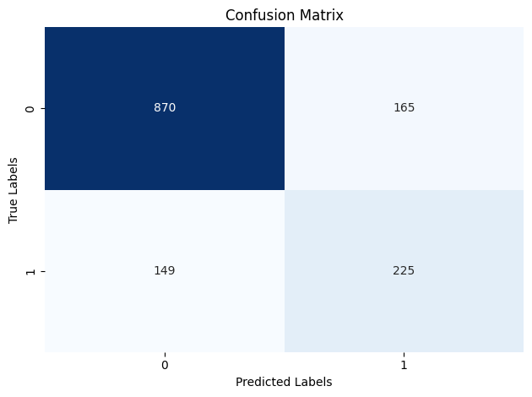
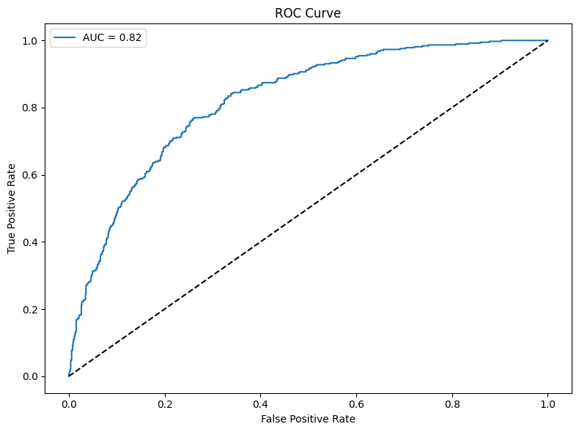
Confusion Matrix
Receiver Operating Characteristic curve (ROC Curve)
Fig: XGBoost Confusion Matrix Before Tuning
Fig: XGBoost ROC Curve Before Tuning

Slide 37
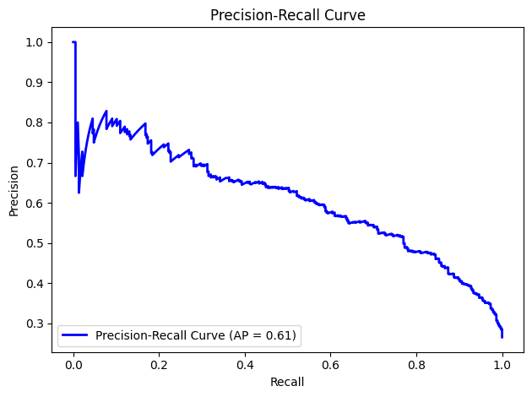
Precision Recall Curve
Fig: XGBoost Precision Recall Curve Before Tuning

Slide 38
5.2 XGBoost After Tuning
Classification Report –
Classification Report (AUC-ROC = 0.843):
precision recall f1-score support
0 0.88 0.80 0.84 1035
1 0.56 0.71 0.62 374
accuracy 0.77 1409
macro avg 0.72 0.75 0.73 1409
weighted avg 0.80 0.77 0.78 1409
Accuracy: 0.774

Slide 39
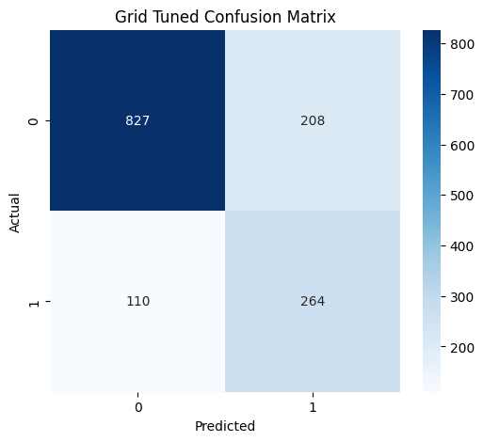
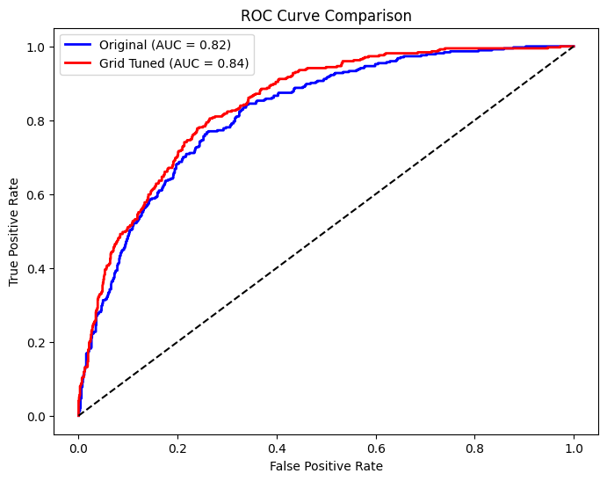
Confusion Matrix
ROC Curve Comparison After Tuning
Fig: XGBoost Confusion Matrix After Tuning
Fig: XGBoost ROC Curve Comparison After Tuning

Slide 40
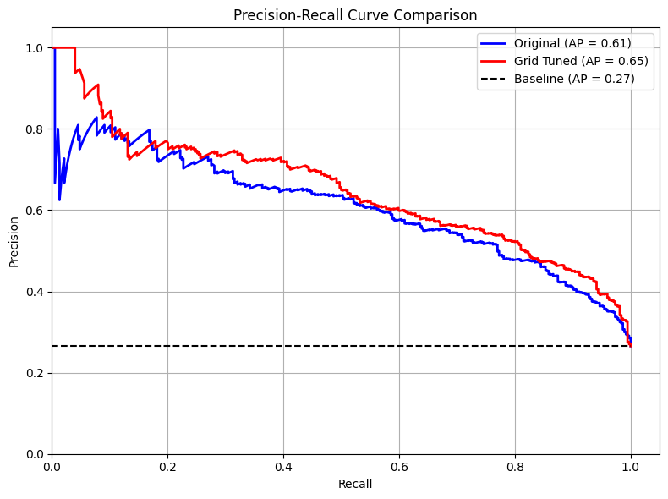
Precision Recall Curve Comparison After Tuning
Fig: XGBoost Precision Recall Curve Comparison After Tuning

Slide 41
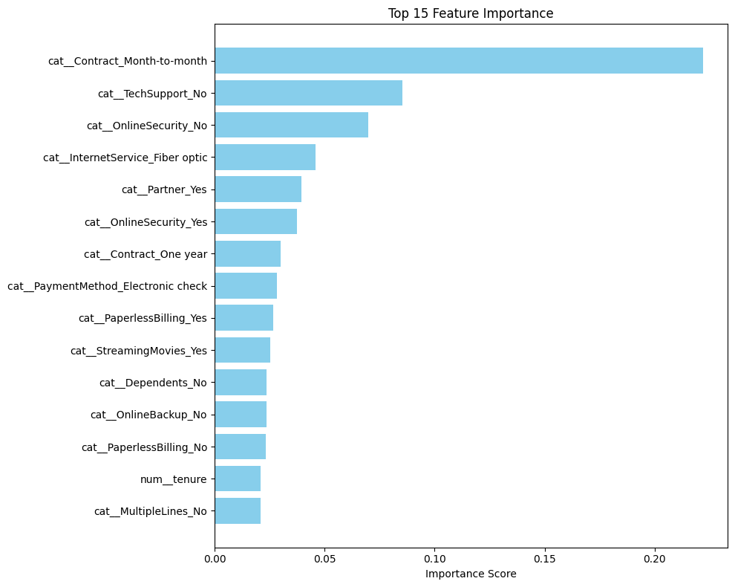
5.3 XGBoost Feature Importance
Fig: XGBoost Feature Importance

Slide 42
5.4 Performance Summary
Metric | Before Tuning | After Tuning | Change
AUC-ROC | 0.821 | 0.843 | +2.2%
Class 1 Recall | 0.60 | 0.71 | +11.0%
Class 1 F1-Score | 0.59 | 0.62 | +5.1%
Macro Avg F1 | 0.72 | 0.73 | +1.4%
Weighted Avg F1 | 0.78 | 0.78 | No Change
Accuracy | 0.777 | 0.774 | -0.3%
The hyperparameter tuning successfully improved the model’s ability to detect the minority class (Class 1) while maintaining overall accuracy. The trade-offs align with typical imbalance mitigation strategies, but further refinement could optimize precision for critical use cases. The AUC-ROC improvement validates the tuning strategy, though domain-specific costs should guide next steps.

Slide 43
06
Conclusion

Slide 44
Conclusion
Predicting customer churn is a critical challenge for telecom companies, where retaining customers directly impacts profitability and long-term sustainability. This project aimed to address this challenge by developing a machine learning model capable of identifying at-risk customers early, enabling proactive retention strategies. Through systematic data preparation, model selection, and hyperparameter tuning, we successfully built an XGBoost-based churn prediction system with actionable insights for telecom businesses.
In conclusion, this project demonstrates the power of machine learning in transforming customer churn prediction from a reactive to a strategic business tool. By combining technical rigor with business context, telecom companies can turn data into actionable strategies, fostering customer loyalty and driving sustainable growth.

